Slide 1
BANK MANAGEMENT SYSTEM
Presented By : Girnala Divya
Batch code : 2021-6138

Slide 2
DESCRIPTION
This is a Bank Management tool which can be used to manage activities like creating a person’s account in a bank, deposit or withdraw the cash from his/her account.
The main purpose of developing bank management system is to design an application, which could store bank data and provide an interface for retrieving customer details with 100% accuracy.
It is a menu driven program and it runs until the user exits.

Slide 3

MAIN MENU
Display All
Search By Account
Deposit
Withdrawal
Exit

Slide 4
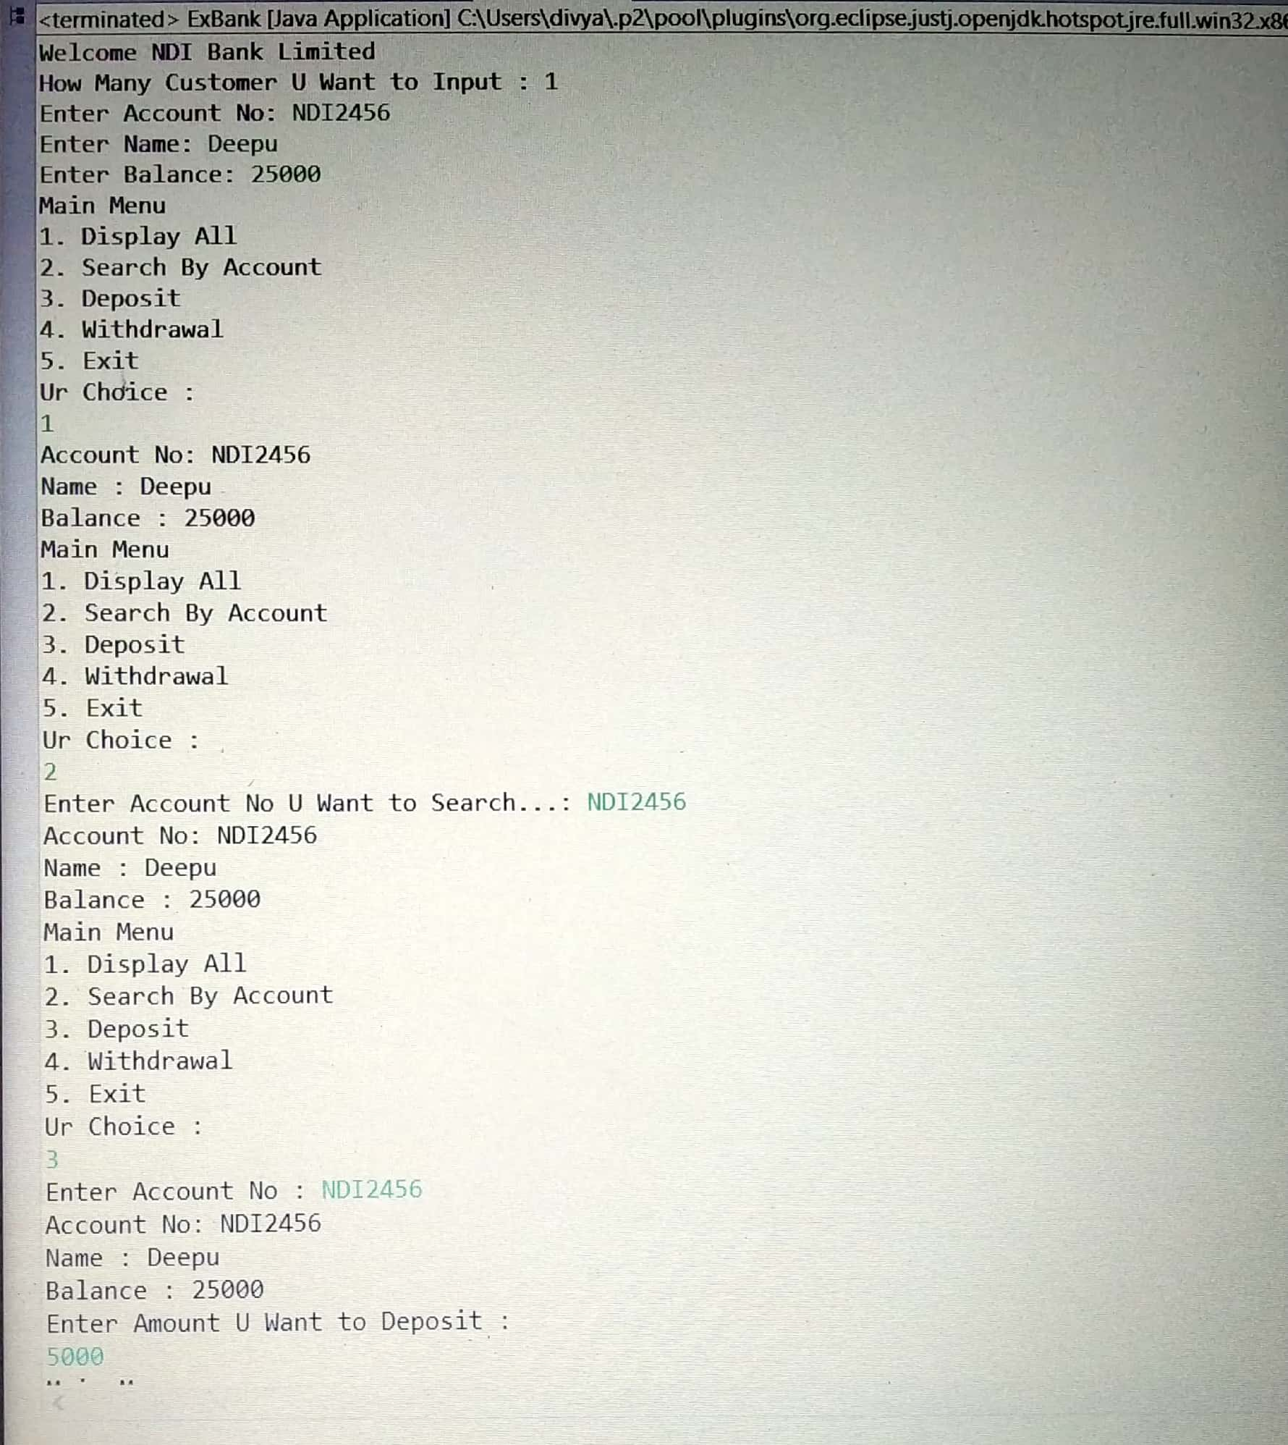
OUTPUT

Slide 5
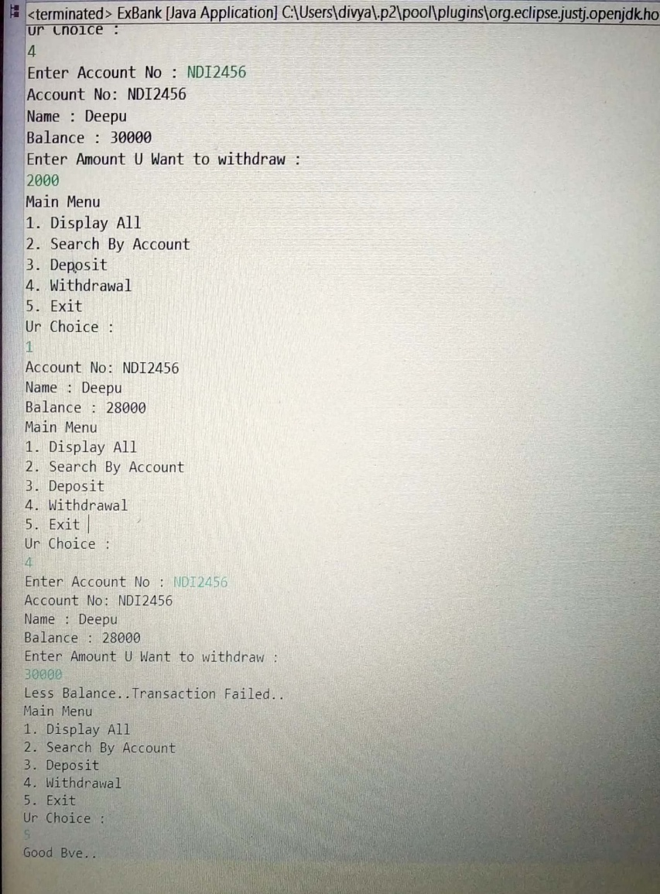

Slide 6


